Slide 1


Final Year Project
Tomato Care
Supervised By: Mr. Muhammad Usman Karim(Lecturer)

Slide 2
Project Team
Muhammad Salman Afaq (24775)
Usman Afaq (24779)
Rafaqat Ahmad (24784)

Slide 3
Table of Content
Opportunity & Stakeholders
Solution
Progress Report Summary
Requirements
Software System (Design + Implementation + Testing)
Endeavour (Team + Work + Way of Working)
Next Steps
Prototype / Report

Slide 4
Opportunity & Stakeholders

Slide 5
Opportunity
Farmers are facing a serious issue with diseases affecting their tomato crops.
Recognition of the need for a more efficient and accessible disease detection solution.
We looked at what's already out there and what farmers might need by doing a lot of research Identified
A gap in existing solutions..
We got inspired by looking at other projects that did innovative things with finding plant diseases.

Slide 6
Stakeholders
Farmers: Detecting diseases early helps farmers grow more tomatoes and spend less on treatments, improving their income.

Slide 7
Solution
Simplifies disease detection for tomato plants
Capture a photo with your smartphone for quick disease identification
Suggests appropriate treatments for the identified disease
Provides information on disease severity
Accessible through a user-friendly mobile app
Designed to make crop protection easy for farmers
Aims to improve crop yields
Text interaction for enhanced accessibility.
Localized alerts and notifications for proactive disease management.

Slide 8
PROGRESS REPORT Summary

Slide 9
User Functional Requirements
ID | Requirements
1.1 | User shall be able to Sign Up.
1.2 | User shall be able to login to their account.
1.3 | User shall be able to view and edit their profile.
1.4 | User can upload images for disease detection.
1.5 | User can access a personalized calendar for plant care.
1.6 | User can give feedback.
1.7 | User can also interact with the FAQs. It will provide relevant answers.
1.8 | User can also view the reports.

Slide 10
Admin Functional Requirements
ID | Requirements
2.1 | Admin shall be able to login into the system.
2.2 | Admin shall be able to Add, edit or remove diseases.
2.3 | Admin shall be able to manage treatments.
2.4 | Admin shall be able to view and manage user’s profiles.
2.5 | Admin can also manage localized alerts.
2.6 | Admin can review the reports.
2.7 | Admin shall be able to manage the FAQs.

Slide 11
Non-Functional Requirements
Performance
The system should provide real-time or near-real-time processing for disease detection to ensure prompt results for farmers.
Response time for uploading images and receiving results should be within an acceptable range.
Security
User authentication and authorization mechanisms should be implemented to ensure that only authorized users (farmers and admins) can access the system.
Data privacy and integrity must be maintained, especially for sensitive information related to the farmer's crops.

Slide 12
Market Survey
Ref | Applications | Tomato- Disease Detection | Treatment Suggestions | Text Interface | Localized Alerts
1 | Toma App | ✔ | ✖ | ✖ | ✖
2 | Tomato Disease | ✖ | ✔ | ✖ | ✖
3 | Diagno Plant Tomato | ✖ | ✔ | ✖ | ✖

Slide 13
Requirements
Our project has two users:
User/Farmer
Admin
Use Cases : 16
Functional Requirements: 15

Slide 14
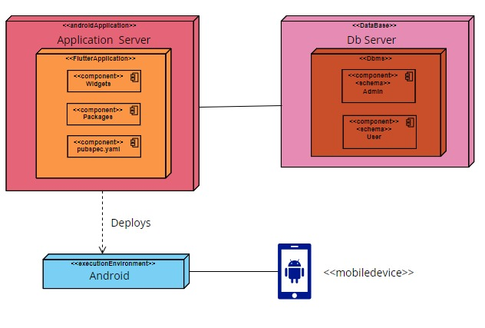
Design

Slide 15
Design
Detailed Design
Architectural Design
Use Cases
Farmer Use-Case Diagram
Admin Use-Case Diagram
Database Schema Diagram
Methodology Diagram

Slide 16
Implementation
Development Tools & Technologies
IDEs and Tools
Backend: Python
Flutter: Visual Studio Code
Collaborative Model Training: Google Colab, Hugging face
Version Control and Document Sharing: GitHub
Technologies
Backend: Python
Framework: PyTorch, Flutter
Machine Learning: CNN Model(RestNet18)
Database: Firebase

Slide 17
Best Practices / Coding Standards
Best Practices
Version Control: GitHub
Continuous Integration and Deployment Practices
Coding Standards
Python: PEP 8
Flutter: Flutter's Coding Standards

Slide 18
Libraries / Components / Web Services
Libraries
PIL(Python Imaging library)
Google.colab
Torch vision(transforms and models)
Components
CNN Model
Flutter Application
Web Services
Flask API
Fire Base Database

Slide 19
Testing
Test Data | TD-1
Form | Login
Stakeholder | User
Field | Email
Technique | Equivalence Partitioning
Valid | Correct length (user@example.com) Includes numeric characters (user123@example.com). Includes country code (user@example.co.uk)
Invalid | Does not contain '@' (userexample.com).Include characters Includes characters (user@exampl*e.com).Not End with ‘.’ Includes special characters (user@ex!ample.com). Does not end with '.' (user@examplecom).

Slide 20
Testing
Test Data | TD-2
Form | Login
Stakeholder | User
Field | Password
Technique | Equivalence Partitioning
Valid | Password length should be >=6 Includes two special characters Includes uppercase and lowercase character Includes one numeric character
Invalid | Password length < 6 No uppercase and lowercase characters No special character No numeric character

Slide 21
Endeavour

Slide 22
Endeavour
Names | Roles
Muhammad Salman Afaq | Front-end, Documentation
Usman Afaq | Model-Train, Front-end, Documentation
Rafaqat Ahmad | Front-end, Back-end, Documentation

Slide 23
NEXT STEPS

Slide 24
Work Breakdown Structure (List of all Deliverables / Strikethrough Completed Deliverables)
Week 1 & 2
Project Idea
Week 3 & 4
Proposal Presentation
Week 5 & 6
Literature Review
Week 7 & 8
Finalized Technologies and Tools
Week 9 & 10
Front-End and Report Documentation
Week 11 to 14
Flutter Development
Back-end development
Week 15 and 16
Model Training
Database Connection

Slide 25
Challenges
Model Training Hurdles
Front-End Development Challenges
Model Integration
Database Connection
Finding Dataset

Slide 26
Prototype & Report

Slide 27
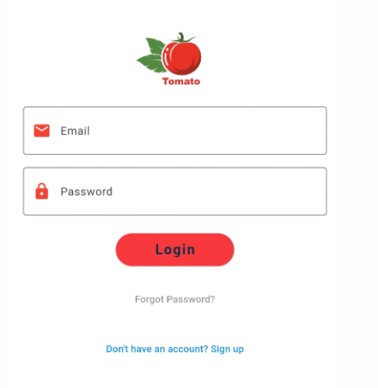
Prototype

Slide 28
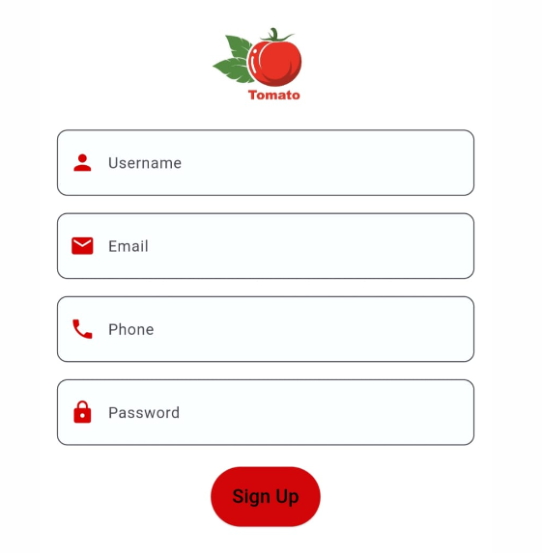
Prototype

Slide 29
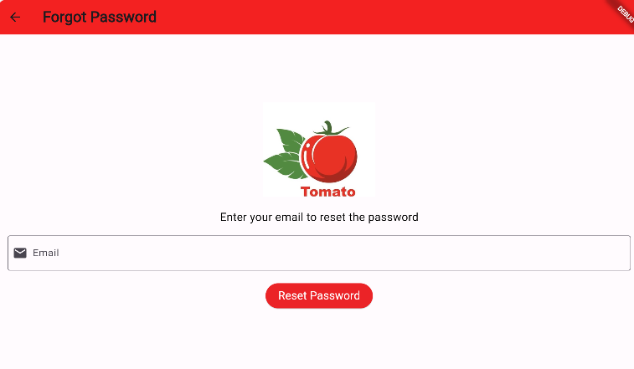
Prototype

Slide 30
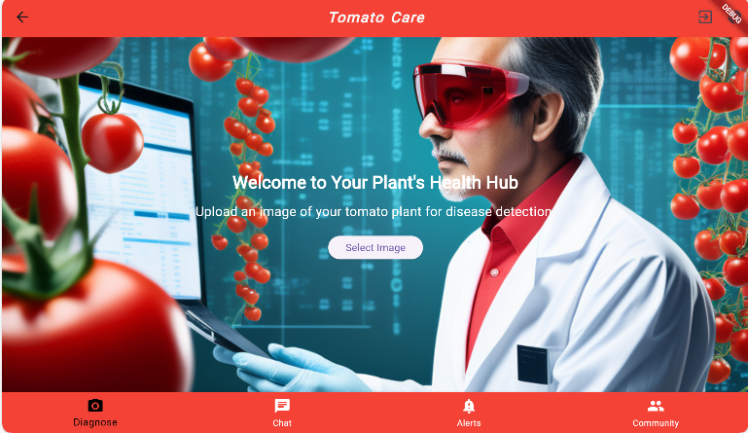
Prototype

Slide 31
Report
Chapter 1: Introduction
Chapter 2: Literature / Market Survey
Chapter 3: Requirement Analysis
Chapter 4: System Design
Chapter 5: Implementation
Chapter 6: Testing & Evaluations
Chapter 7: Conclusion & Outlook

